Slide 1


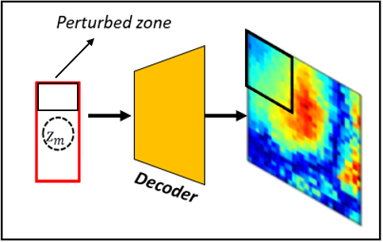
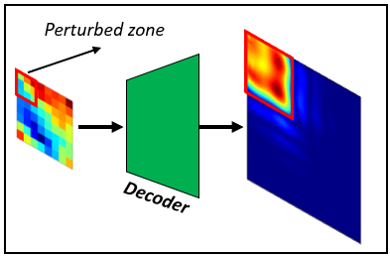
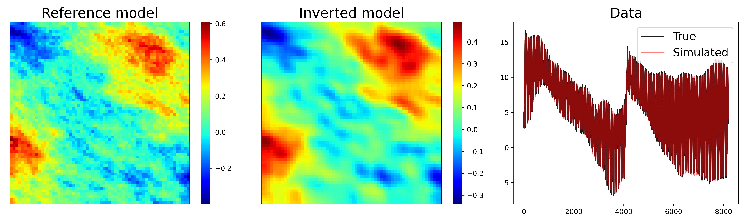
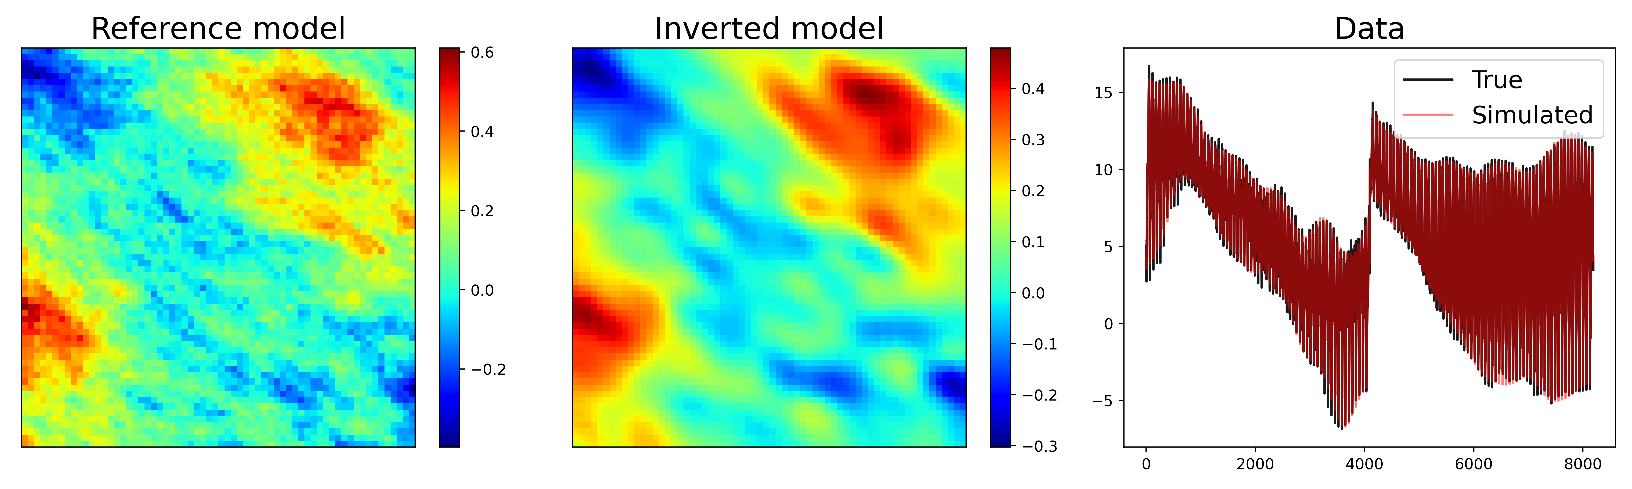
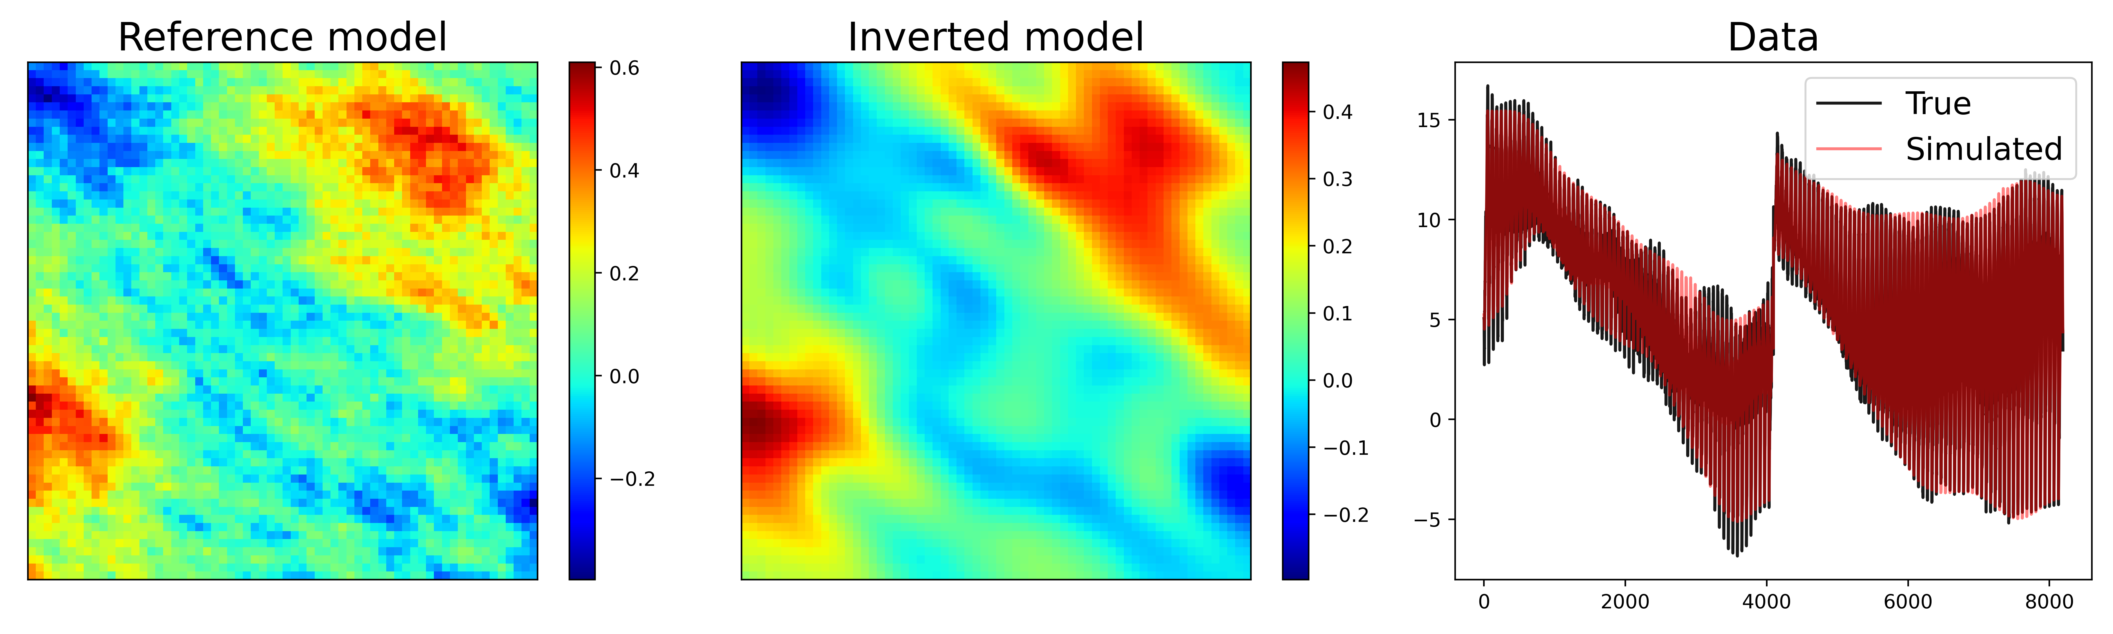
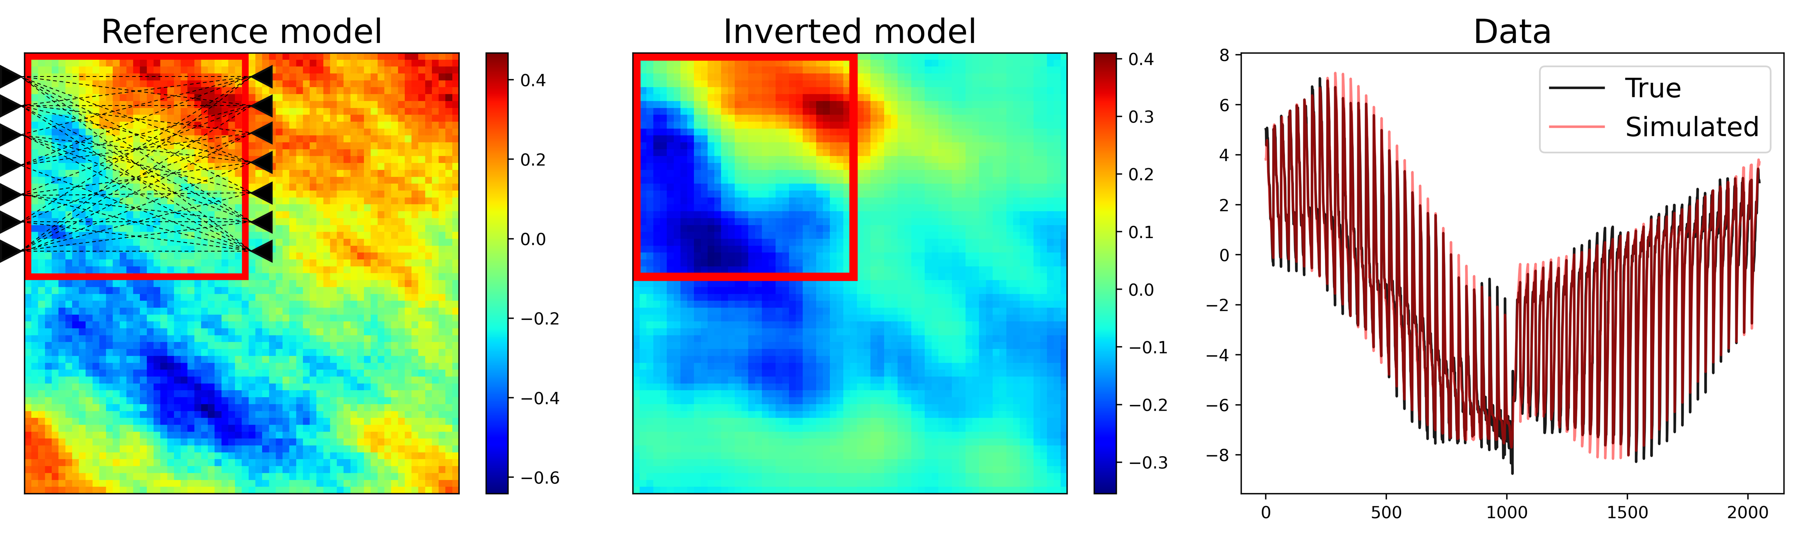
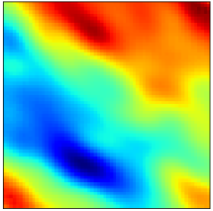
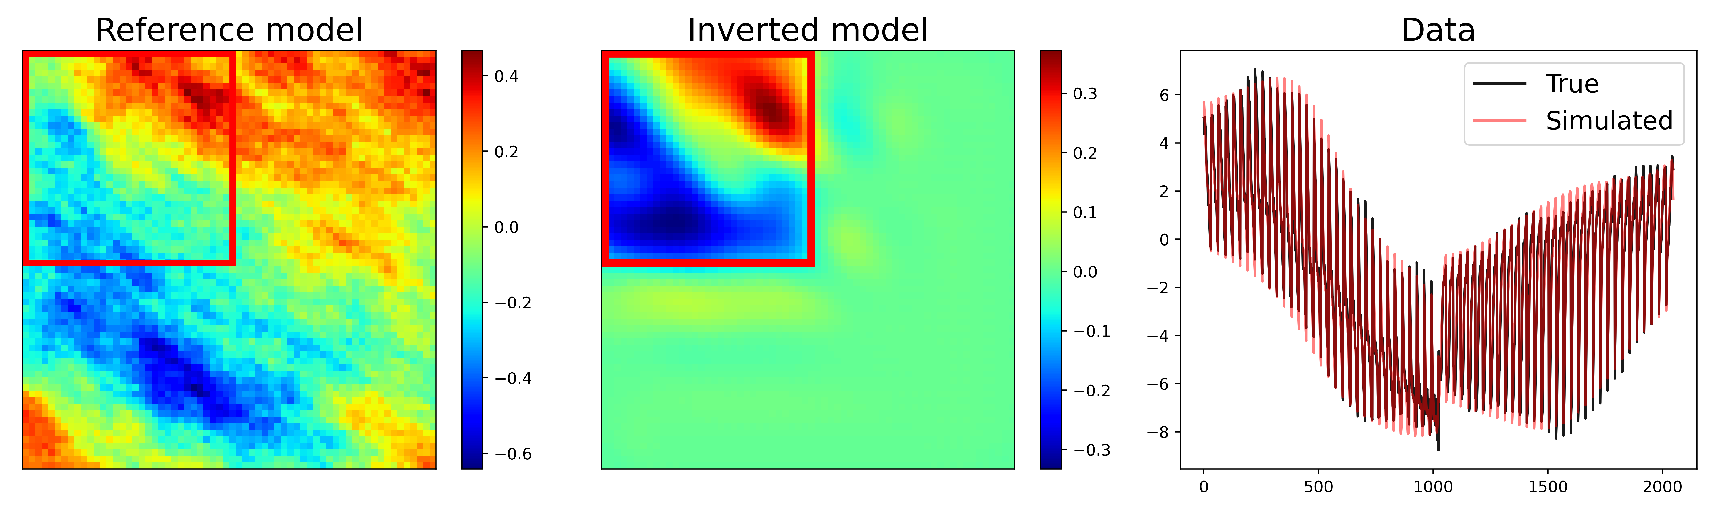
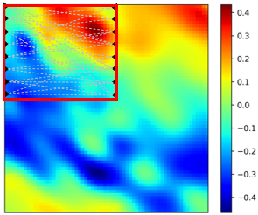
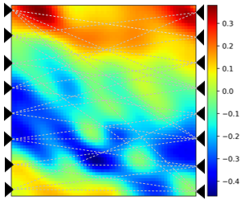
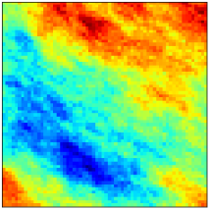
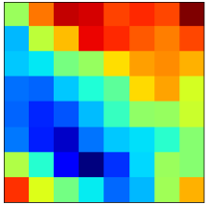
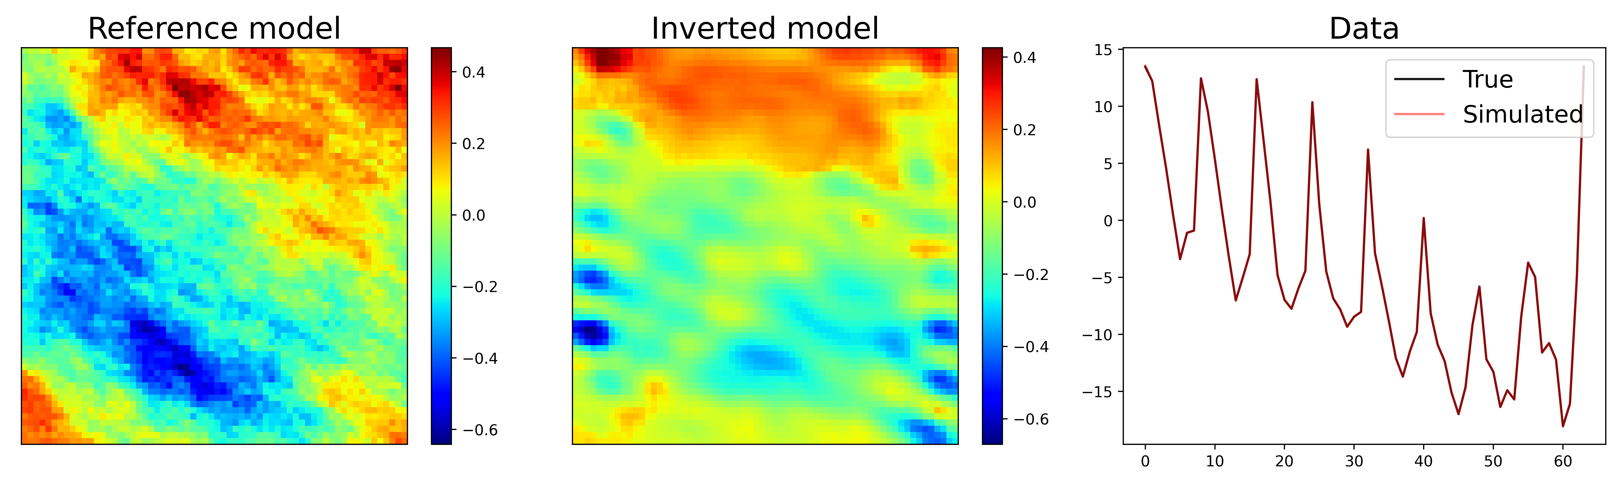
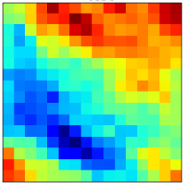
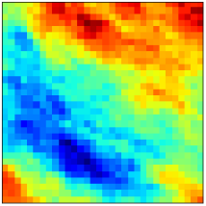
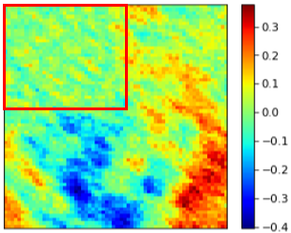
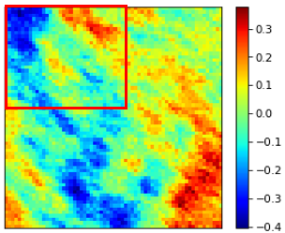
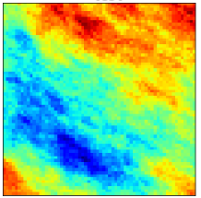
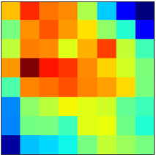
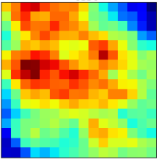
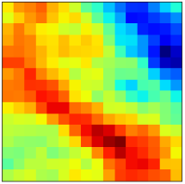
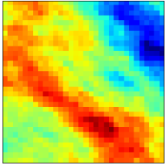
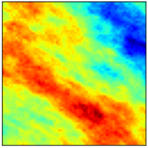
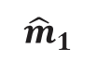
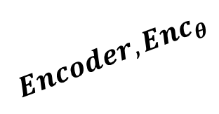

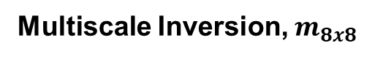
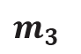

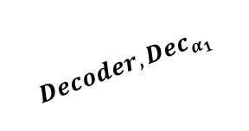

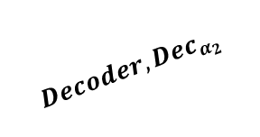
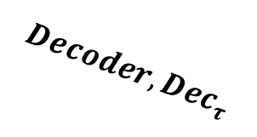
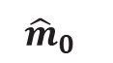
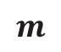
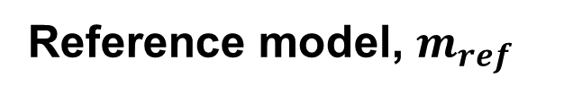
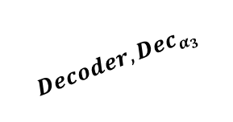
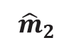



Deep Learning-based Multiresolution Parameterization for Spatially Adaptive Model Updating (SPE-212167-MS)
Mahammad Valiyev (email: valiyev@usc.edu), Syamil Mohd Razak, Behnam Jafarpour
Motivation
Results & Discussion
Problem statement
Objective
Results 1. Local model calibration
Results 2. Multiscale model calibration
Black
Box
Output
Reference model
Multiscale inversion, 32×32
Multiscale inversion, 16×16
Multiscale inversion, 8×8
Autoencoder
Input
Updates beyond data sensitivity
No control over which regions get updated
Deep Learning models are black box
Latent space of AE is abstract,
lacking spatial interpratability
Introduce spatial interpretability to latent space
The introduced architecture enables multiscale model calibration
Multiscale model calibration allows data to be incorporated at the right scale
Large-scale updates are performed on coarse scale model -> computational efficiency
Methods
Autoencoder architecture
Spatially Adaptive & Multiresolution architecture
$${Decoder, Dec}_{α_{1}}$$
Spatially Adaptive & Multiresolution
Results 3. Multiscale & local model calibration
$${Decoder,Dec}_{α_{3}}$$
$${Decoder, Dec}_{α_{2}}$$
Reference model, $m_{ref}$
Multiscale Inversion, $m_{16x16}$
Multiscale Inversion, $m_{8x8}$
Input
$m_{3}$
Output 3
Updates according to data sensitivity
No updates to other regions
Input
$$z_{m}$$
Reconstruction
$${\hat{m}}_{0}$$
$$m$$
$$\hat{m}$$
8x8
$$Latent code$$
Output 1
$${Encoder, Enc}_{θ}$$
$${Decoder, Dec}_{τ}$$
$${\hat{m}}_{2}$$
Output 2
64x64
Residual: $m_{ref}−m_{16x16}$
Residual: $m_{ref}−m_{8x8}$
$${\hat{m}}_{1}$$
2 modifications to standard AE:
Replace encoder with upscaling function
Constrain intermediate outputs with loss functions
16x16
Multiscale & local updates allow resolving data and model resolution disparity
Changes enable:
Spatially adaptive/informed latent spaces
Multiresolution output capability
32x32
Single scale model calibration
Conclusion
Further work
Scale 1
Scale 2
Scale 3
New autoencoder architecture is introduced to enable
Spatial interpretability of latent spaces and
Multiresolution representation capability
These two properties enhance the efficiency, flexibility, and interpretability of parametrization and inverse modeling
Additional experiments involving multiphase flow problems and more complex geologic settings, to provide further insight into the properties of the method
Extension of the method for use with ensemble-based history-matching techniques
Development of alternative Deep Learning architectures for more efficient introduction of spatial interpretability of latent spaces
Coarsen
HM
Refine
HM
Refine
HM
Initial fine scale model
Multiscale model calibration
Matched fine scale model
Multiscale model calibration with spatially adaptive update capability enhances:
1) efficiency and 2) flexibility

